Slide 1
GEOGRAPHY AND TIMESTAMP OF SPAM TWEETS
GROUP MEMBER’S:
Anitha Nari - 11550658
Vijayalakshmi pepala - 11656632
Monisha Mahitha boddu - 11513712
Mounika nuchu - 11653658

Slide 2
Introduction:
Sentiment Analysis:
In this project the tweets which are provided in the dataset are preprocessed and cleaned. The data need to be divided based on training data and test data. We have used Naive Bayes classification model for this project. The tweets are determined if they are spam or not. Based on the results the sentiment analysis is performed.

Slide 3
Motivation
Twitter stands apart from other online social networks due to its distinctive friend-following and posting features. One the one hand, friendships on Twitter aren't always reciprocal. Users can "follow" celebrities, for instance, without expecting them to do the same.
Each geo-tagged tweet's adjacent location was vectorized as an ego network as well. After that, the vectorized location and word embeddings were combined, and they were input into the CNN and BiLSTM networks to train and categorize the sentiment labels of the tweet.

Slide 4
Objective
Because tweets are brief and noisy, it is difficult to predict where people will be when they will tweet or go home. It is customary to use location- and tweet-specific methods and information while implementing recognition and disambiguation procedures for formal papers.

Slide 5
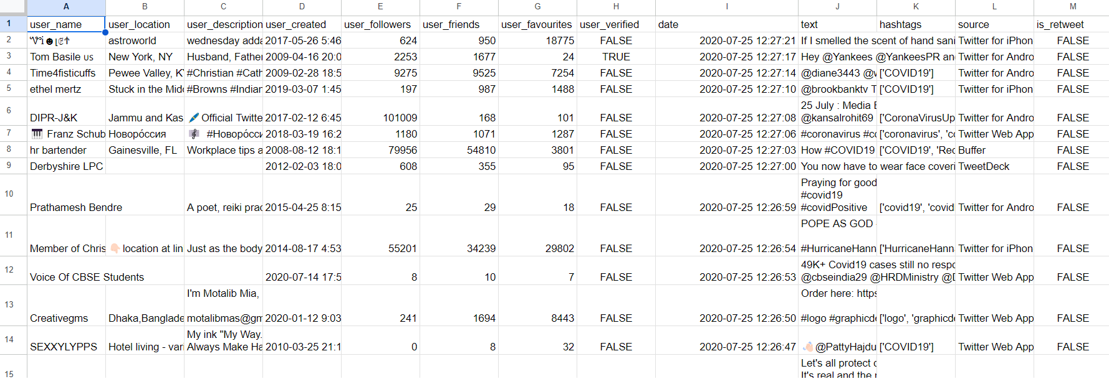
Methodology
Data Collection:
The dataset contains the information of the tweets, Timestamp, dates, location, username, user description, user friends, user followers, user tweets, hashtags, source. The link of the dataset where it is uploaded is shown below in
https://www.kaggle.com/datasets/anithanari/geographyandtimestampofspamtweets

Slide 6
Data Analysis
We have taken the data set from various sources.
Combined the data of Github tweets and Kaggle dataset.
All the tweets are gathered and performed whether they are positive tweets or Negative Tweets.
By using Different Corpus for example NLTK
We have performed the process of Tokenization and Stemming techniques.

Slide 7
Tools
Multiple tools and techniques are used for the detection of spam tweets and their location.
Importing different python libraries like np, numpy, pandas, textblob.
Machine Learning Techniques:
Regression Technique.
Tokenization-NLP technique
Naive Bayes Algorithm.

Slide 8
Video Link:
https://www.youtube.com/watch?v=Ow5UDUKU_Nk

Slide 9
THANK YOU !!

